Slide 1
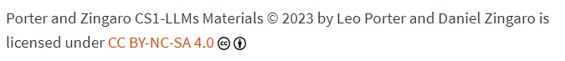
CSE 8A – Introduction to Programming and Computational Problem Solving I
Automating Tasks + Python Modules
How to get help:
Class Website
https://sites.google.com/ucsd.edu/cse8afa23/home
Piazza for brief questions or logistic questions
Tutor Hours for help with homework/setting up computer To get help, use Autograder (directions on piazza)
Office Hours for homework/conceptual help
Slides based, in part, on materials from Dan Zingaro.
Notes:
Welcome!

Slide 2
Announcements
Grades Posted on canvas (including participation!)
Please review piazza post and check your grades
If correction needed, make a private post on piazza
Need all corrections in piazza by Thursday 12/7
Project 3 on games!
Due Friday
No late deadline, must be on time to be graded
End-of-quarter survey coming soon
Must complete SET/CAPEs before completing
Worth 2% bonus on your final exam score
Final exam in ~1.5 weeks
Will be a multi-part exam with some using Copilot
Must be able to use the lab machines
Also be sure you have Copilot setup on your personal machine and that you can sign into GitHub.
Discussion Friday is a final exam review!

Slide 3
Learning Goals for Today
By the end of today’s lecture, you should be able to:
Use Copilot to help identify Python modules
Identify if a module may be helpful for your task
Write basic code using modules for processing Word documents

Slide 4
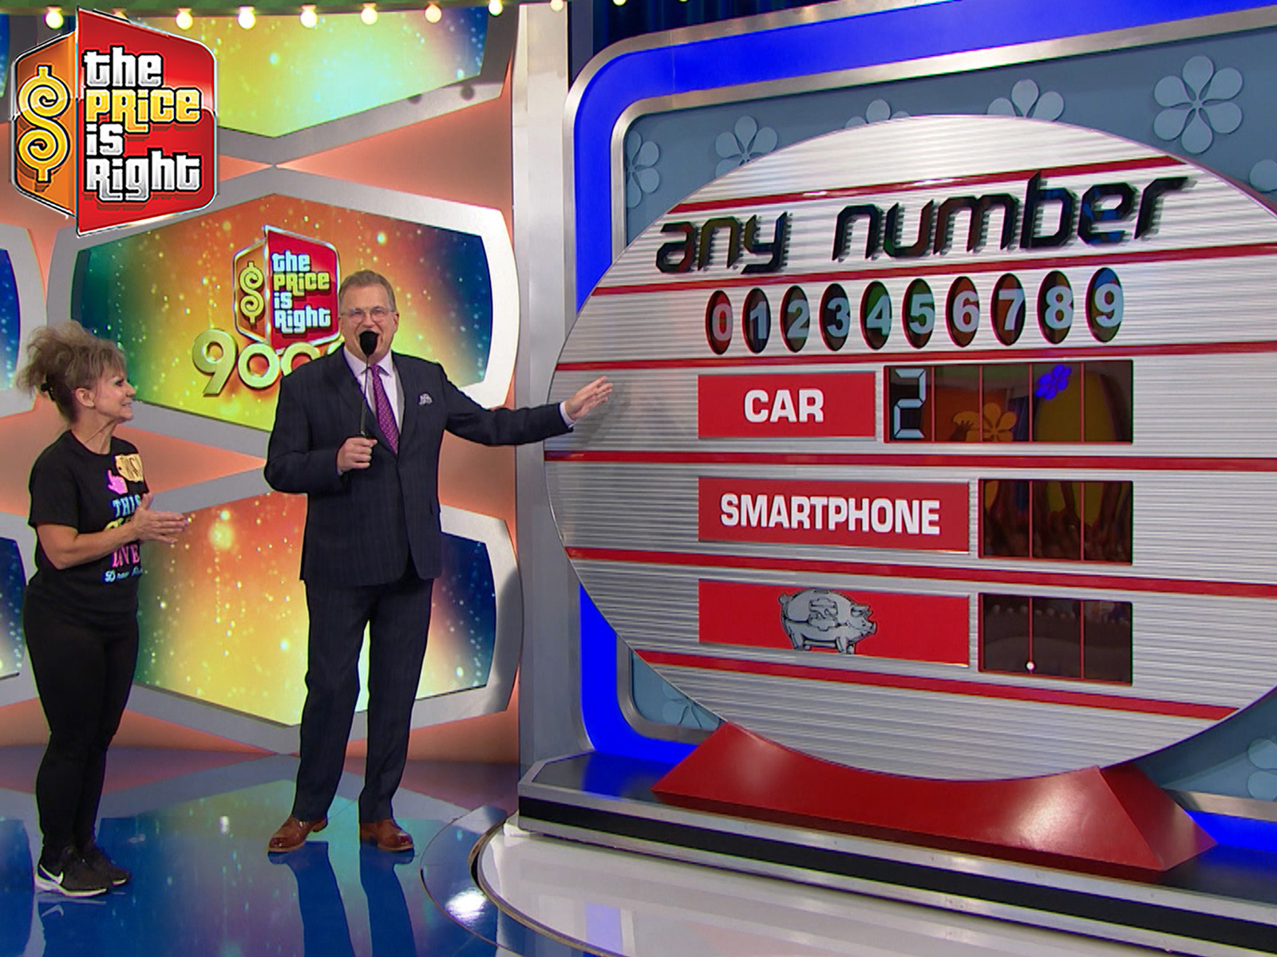
Remember: The Game – “Any Number”!
Rules:
Each digit appears once on the board (except the first digit in the big prize in modern episodes)
The player receives the first prize that has all the numbers completed
Any Number from the Price is Right: credit Amazon
Notes:
Original game on the Price is Right!

Slide 5
Our Big Picture Goal
Write the code to create two things:
A playable game by the player
A game we can simulate running repeatedly to determine the likelihood of winning
Notes:
List of lists – separate solution and current board
List of lists with tuples
Single list, we manage the math behind the scenes
Pretend there’s a solution and we create it as we go along. Possibly harder to debug.
Dictionary idea from Dan
Check for duplicate guesses or silent fail?

Slide 6
Reminder: play_game(board, solution)
def play_game(board, solution):
debug = True
while check_win(board) == -1:
if debug:
print_state(solution)
print_state(board)
guess = int(input("Enter a number from 0-9:"))
process_guess(guess, board, solution)
win = check_win(board)
if win == 0:
print("You won the car!")
elif win == 1:
print("You won the appliance.")
else:
print("You won the bank.")
Notes:
It filled this in correctly, but wait a second…. I feel this might have drawn from a solution I’d written by hand because the outputs are more than I’d specified. ☹ Time to discuss how it can draw from other code it’s seen recently.

Slide 7
Simulation – Top-Down Design
Notes:
We’ll just need a new version of play game that uses a random number between 0-9 rather than user input!
Functions:
play_game_automated
simulate_games(n)

Slide 8
play_game_automated
def play_game_automated(board, solution):
"""
Similar to play_game, play the game once by using random guesses
between 0-9 without user input. Return what was won as the
number 0 (car), 1 (appliance), or 2 (bank).
"""
debug = False
while check_win(board) == -1:
if debug:
print_state(solution)
print_state(board)
guess = random.randint(0,9)
process_guess(guess, board, solution)
win = check_win(board)
if win == 0:
return 0
elif win == 1:
return 1
else:
return 2
Is there anything wrong with this solution?
Yes, there’s a bug in how the game is played
Yes, the function returns the wrong value
Nothing incorrect, but it could be a problem calling it repeatedly.
The code is fine
Notes:
The print is great and we want this for testing, but when we move to automation, printing is a problem.
Also, the logic is ugly. It should just return check_win(board), but it’s not wrong.
In addition, point out it guesses duplicates but that’s okay.

Slide 9
Simulate_games
def simulate_games(n):
""" using play_game_automated, run n games and return a list of
the number of times the car was won, the appliance was won,
and the bank was won.
"""
wins = [0,0,0]
for i in range(n):
wins[play_game_automated(board_setup(solution_setup()), solution_setup())] += 1
return wins
Notes:
Copilot did almost all of this
That one line is a big ugly, imo. I’d break that into separate lines for readability. And if we did, we’d see the problem. It actually calls solution_setup() twice which means there are two “solutions” running around. This is also a bit more inefficient since solution_setup takes some time. It doesn’t actually impact anything in terms of correctness when running it automated, but it is inefficient and wouldn’t be right if a player played it, so we should really rewrite it.

Slide 10
Simulate_games
def simulate_games(n):
""" using play_game_automated, run n games and return a list of
the number of times the car was won, the appliance was won,
and the bank was won.
"""
wins = [0,0,0]
for i in range(n):
solution = solution_setup()
board = board_setup(solution)
wins[play_game_automated(board, solution)] += 1
return wins
So, how often do you think the player wins the car?
>33%
>30% but less than 33%
>25% but less than 30%
>20% but less than 25%
<20%
Notes:
Just run it. The answer is ~25.6-25.8%. This can be calculated using probabilities but that’s outside this course.

Slide 11
What more could we do with this? (some ideas)
Get a database of car/appliance prices and use them to use real numbers. (The fun there is ensuring no overlap in numbers.)
Figure out how much a hint could help a player. Maybe they can ask once if a number is in the price of any single item – e.g., is 8 in the price of the car?
Keep track of numbers more commonly guessed by human players and bias those common numbers toward lower value prizes
Notes:
What more could we do with this?

Slide 12
Automating Tasks / Python Modules
Notes:
We’ll just need a new version of play game that uses a random number between 0-9 rather than user input!
Functions:
play_game_automated
simulate_games(n)

Slide 13
When should you use Python modules?
When you want to work in a new domain in Python, there’s a module that could help, and you don’t know how to code it yourself
Whenever you are working in a new domain in Python, there’s a module that could help, and you don’t want to code it yourself
Whenever you work in a new domain in Python and there’s a module that can help
Notes:
B or C, but really C – there’s no reason not to use existing modules unless they just can’t do what you want. They are going to be better designed and tested than something students will write themselves. They also tend to be well optimized.

Slide 14
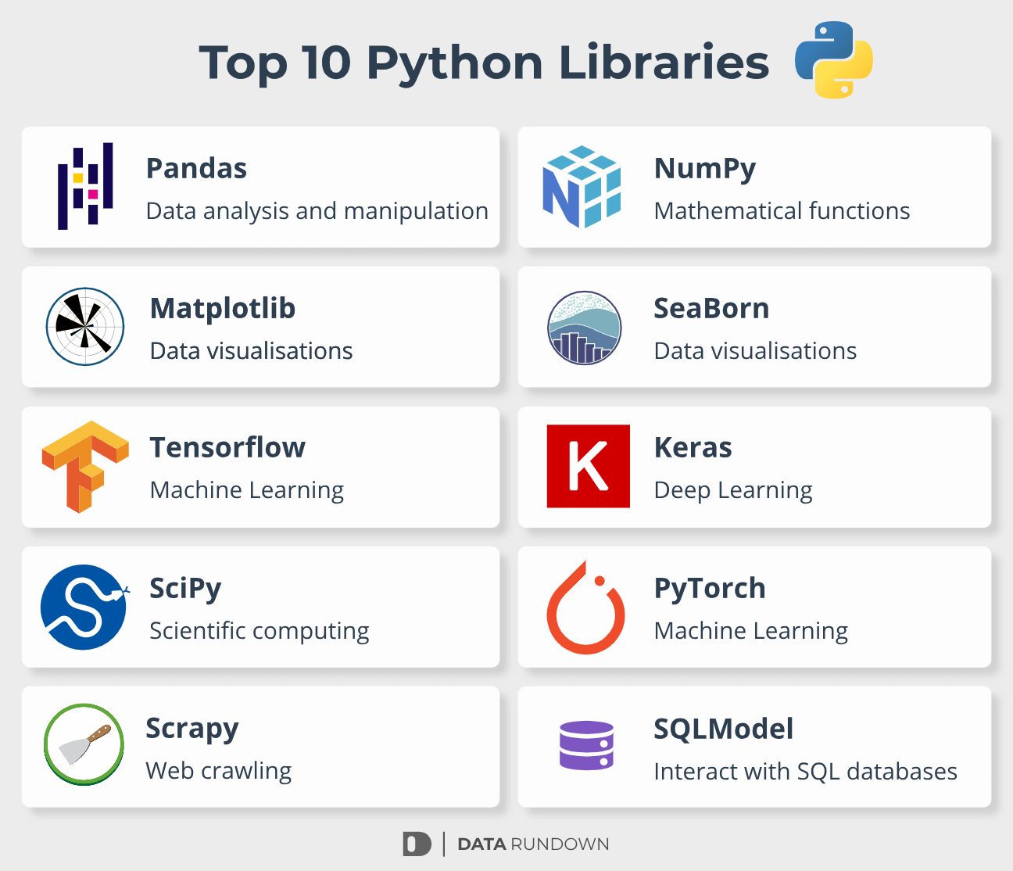
Python Modules
Lots of domains have already pre-created supporting libraries!
Better to leverage these existing tools than try to recreate it yourself.
datarundown.com – recommended data science packages
Notes:
I really appreciate the top 4 and you’d likely use these 4 if you get into data science.

Slide 15
Other useful libraries
Pygame
Great way to get up and running with graphical video games like platformers
Sci-kit learn
Popular machine learning package
https://scikit-learn.org/stable/
Packages for Application Programming Interfaces (APIs)
Allows for easy interaction with websites like Google, Facebook, LinkedIn, etc.

Slide 16
Python Modules
Common issue when facing a new problem: “How do I even get started?”
Asking Copilot if there are modules to help is often a great starting place

Slide 17
Automating Tasks
Notes:
We’ll just need a new version of play game that uses a random number between 0-9 rather than user input!
Functions:
play_game_automated
simulate_games(n)

Slide 18
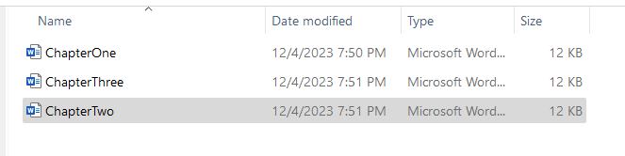
Example problem – word count across Word docs
I have a folder with a bunch of word documents and I want to know how many total words are in the documents

Slide 19
Example problem – word count across Word docs
Can we read the files using the way we read text files earlier in the class?
Yes
No
Notes:
B. No. they are binary files, not text files.

Slide 20
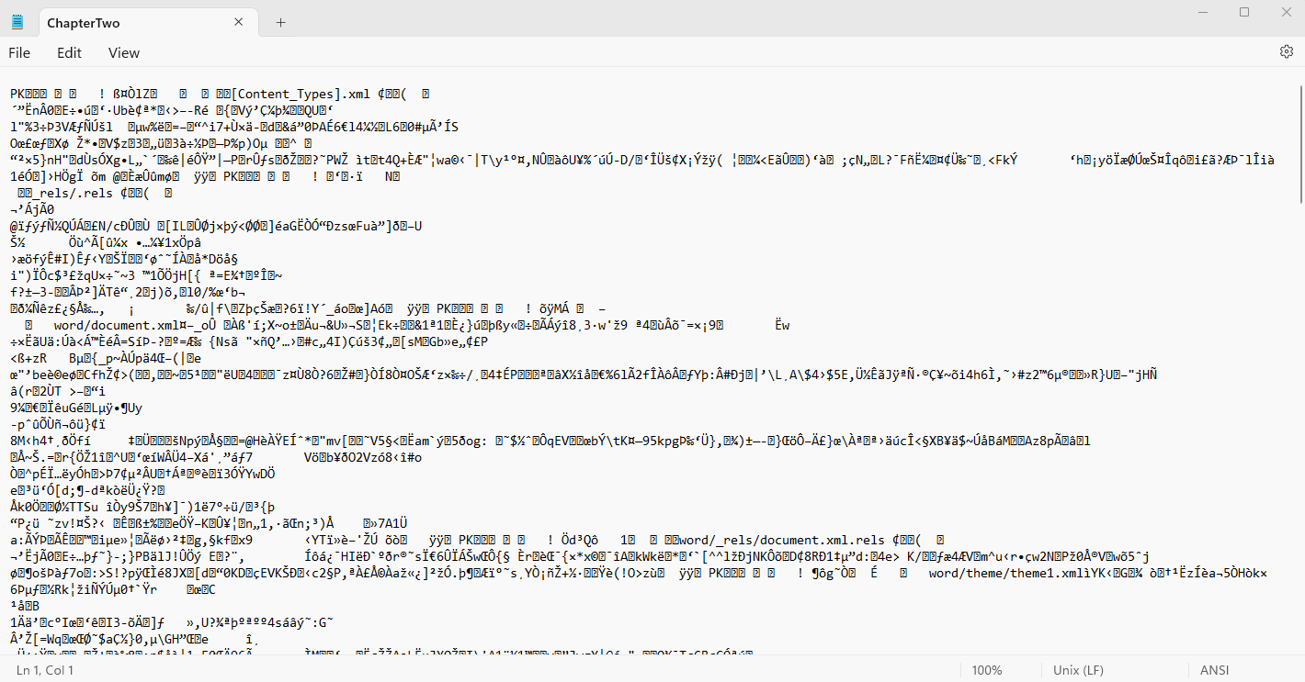
ChapterTwo.DocX – as text..

Slide 21
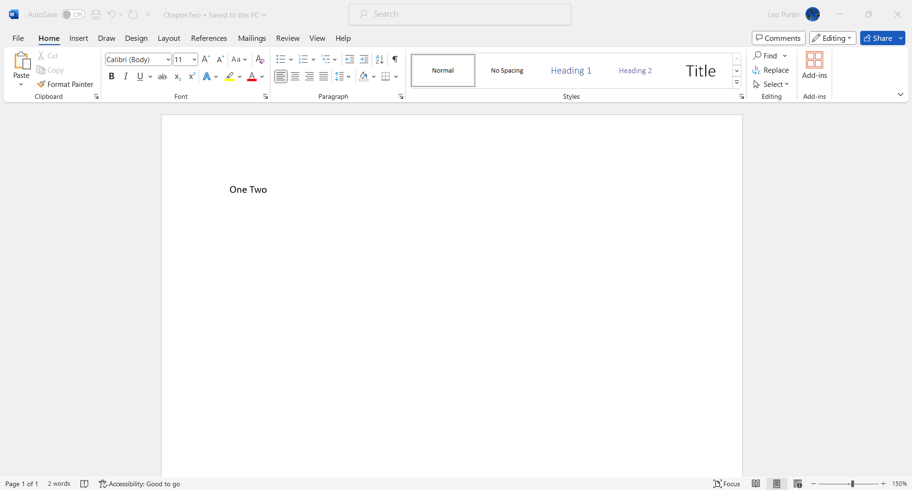
What’s really in ChapterTwo.docx?

Slide 22
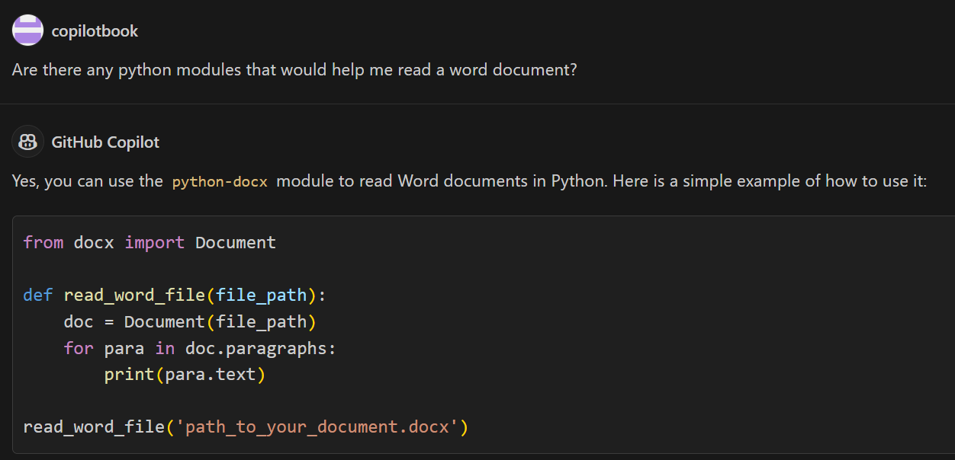
Let’s ask Copilot
Notes:
Hmm.. That seems really convenient. Does it need to be installed? Oh, it already told us that…

Slide 23
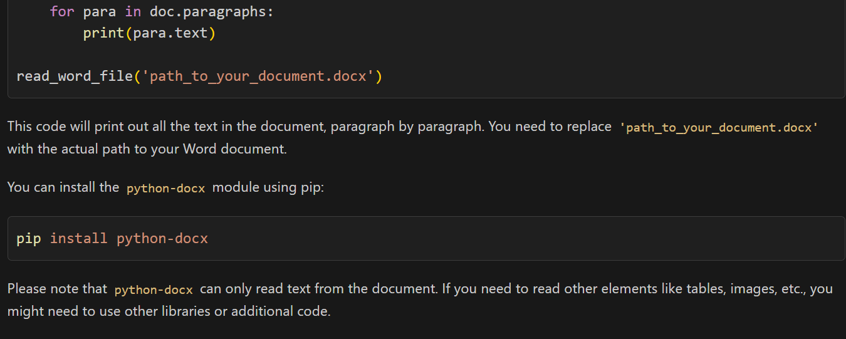
Let’s ask Copilot (continued)
Notes:
Let’s ask to see if there’s a way to get a word count from a Word Document?

Slide 24
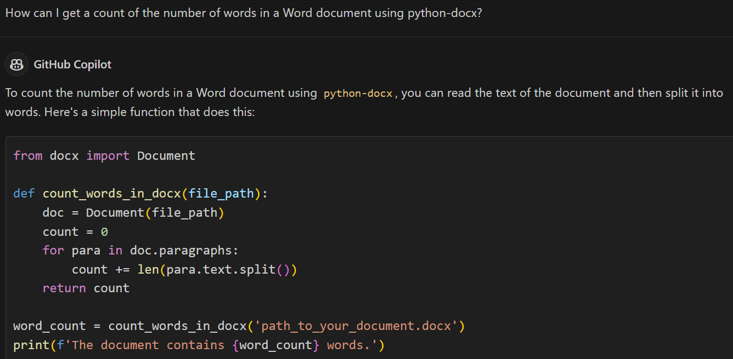
Notes:
Wow, that’s a great start. I don’t know what these paragraph things are – I might assume they are real paragraphs but that’s not actually the case if you look at the documentation.

Slide 25
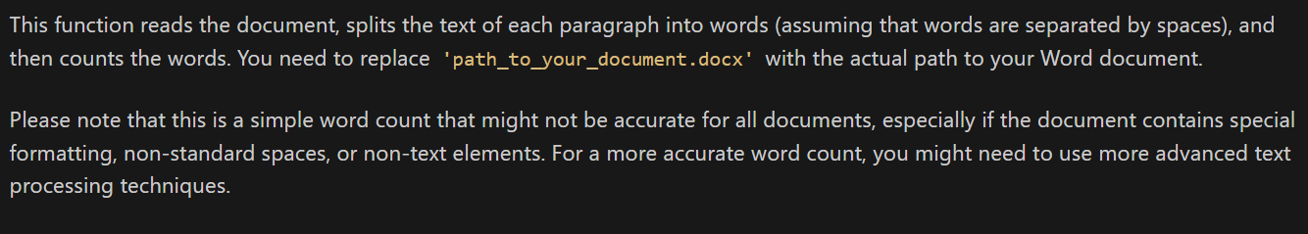
Notes:
Still, that’s enough for me to get started!

Slide 26
Let’s test the function!
from docx import Document
def count_words_in_docx(file_path):
doc = Document(file_path)
count = 0
for para in doc.paragraphs:
count += len(para.text.split())
return count
word_count = count_words_in_docx('ChapterTwo.docx')
print(f'The document contains {word_count} words.')

Slide 27
Write the function below in groups
from docx import Document
def count_words_in_docx(file_path):
doc = Document(file_path)
count = 0
for para in doc.paragraphs:
count += len(para.text.split())
return count
word_count = count_words_in_docx('ChapterTwo.docx')
print(f'The document contains {word_count} words.')
def sum_words_across_files(list_of_filenames):
Notes:
Have them code this in groups
def sum_words_across_files(list_of_filenames):
total_count = 0
for filename in list_of_filenames:
total_count += count_words_in_docx(filename)
return total_count

Slide 28
Testing that new function….
def sum_words_across_files(list_of_filenames):
list_of_filenames = ['ChapterOne.docx', 'ChapterTwo.docx', 'ChapterThree.docx']
print(sum_words_across_files(list_of_filenames))
Notes:
Whoa! This worked really well.

Slide 29

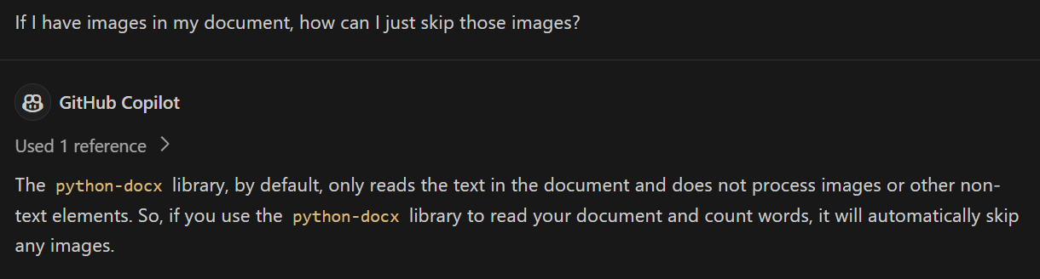
What if I have images in my document?
Notes:
But wait, what if I have images in my document…. Turns out images aren’t a problem! Done and done.

Slide 30
So many problems you might want to solve!
Send customized e-mails to everyone in a csv file
Smtplib (Simple Mail Transfer Protocol – SMTP)
Merge csv files
Pandas, csv, numpy
Track keywords on X (Twitter) about your company
Tweepy
Track historical stock prices
Yfinance
Perform speech recognition
speech_recognition
Music Analysis
Librosa, Music21, PrettyMIDI, pydub, eyed3
Libraries were suggested by Copilot and included starter code!!
Notes:
Turns out images aren’t a problem! Done and done.

Slide 31
Summary
Python modules are a powerful way to get started working in nearly any domain
Copilot can help you find modules and give you code to get you started
After this class, whatever tedious tasks you encounter, please consider using Copilot and Python tools

